Slide 1
Introduction to Compliance Services
What it is, what to expect and how it helps your business

Slide 2

Cybersecurity Landscape
Data breaches up 68% YoY across industries, including regulated industries like healthcare, finance, government and many more.
Ransomware, cloud exploits, threat actors on the rise.
Notes:
Source: Information is Beautiful

Slide 3
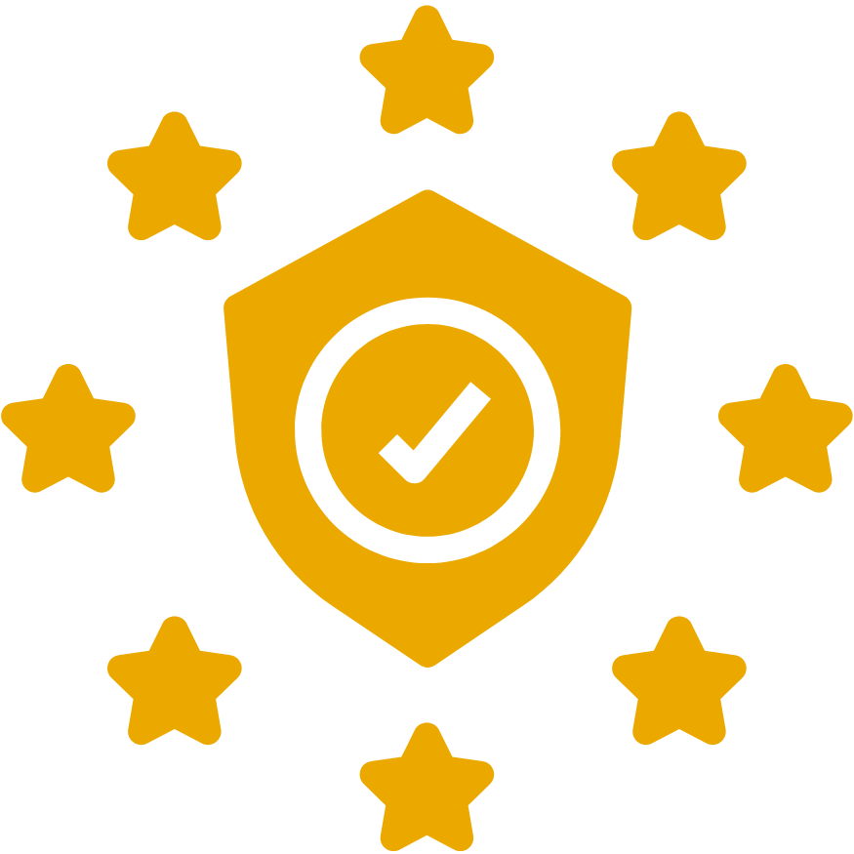
An ongoing process of improving business security posture through:
Alignment with security policies and procedures based on industry standards (frameworks)
Reducing Risks through assessment and monitoring of compliance with best practice standards
Eliminating compliance violations
So, what is cybersecurity compliance?

Slide 4
A compliance framework is a structured set of guidelines that details an organization's processes for maintaining accordance with established regulations, specifications or legislation.
In general, these are a set of industry best practices to follow and align with which help improve an organization’s security posture.
Examples:
What is a compliance framework?
SOC 2 (for cloud-based companies) | ISO 27001 (international standard) | GDPR (EU privacy) | HIPAA (health data privacy) | CMMC (DoD contractors)

Slide 5
Reduce the risk of cyber attacks
  Breaches are on the rise, but that doesn’t mean you can’t be prepared
Avoid regulatory fines
  Compliance laws change and non-compliance can come with hefty fees
Build trust with customers
  Customers want to trust you in protecting their information
  Compliance set’s the bar to meet industry standard due-diligence requirements
Why is compliance important?

Slide 6
Compliance is no longer an option

Slide 7
Identify all applicable laws, regulations, and standards that affect their business/industry
Discover areas where the organization fails to meet industry laws, regulations, and standards
Implement controls and procedures to effectively comply with industry laws, regulations, and standards
Monitor updates and changes to the laws, regulations, and standards that shape their industry
All organizations must:

Slide 8
Highly regulated industries
Finance (FTC Safeguards Rule, CIS Controls, etc.)
Healthcare (HIPAA)
Government contractors (CMMC)
Services Organizations (SOC 2)
Basically, any company that stores sensitive data
Organizations with high quality standards
Stand out amongst the competition
Who needs compliance?

Slide 9
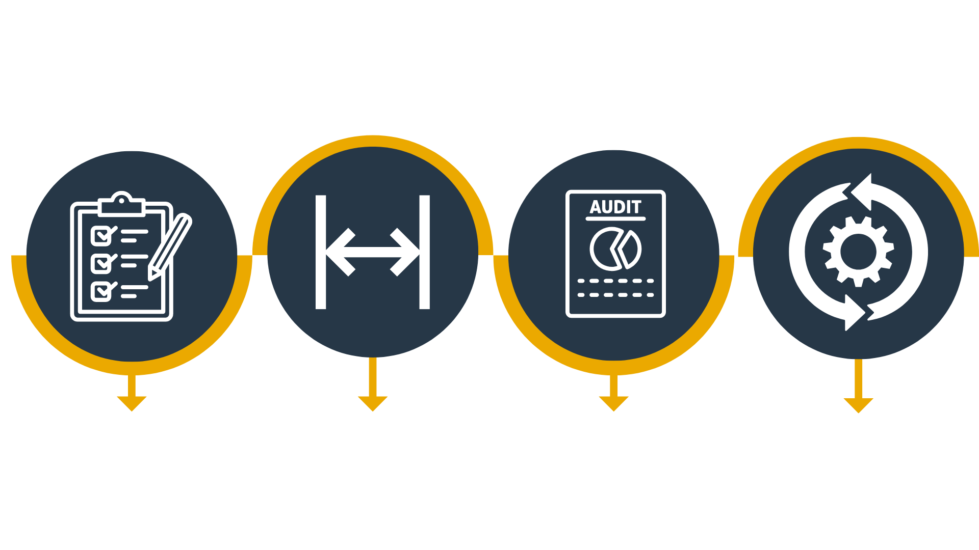
The Compliance Journey
ASSESS
Create a baseline for current procedures, policies and controls; determine path
IDENTIFY GAPS
Ensure controls are healthy and gaps are remediated in timely manner
AUDIT
Ensure controls are meet standard(s)
Share results with 3rd parties for due-diligence
MONITOR
Stay current on policies, procedures and controls over time to remain compliant

Slide 10
[Company Name] automates your compliance journey from launch, to audit and onward
[Company Name] works from where you’re at. Our technology, templates, and procedures jumpstart your compliance program, no matter your current program looks like
[Company Name] automates evidence collection, reporting and monitoring so you don’t have to
[Company Name] We are your compliance partner, doing the heavy lifting to keep your org compliant while you enjoy peace of mind
Why work with us?

Slide 11
Minimal in-house compliance work:
Don’t waste time investigating legislative changes, handling data security, and putting together documents for regulatory bodies
Simplified security procedures:
Get tools and resources to streamline your administrative procedures and keep security at the forefront
Automatic system updates:
Eliminate the hassle of updating your system each time regulations change
What you get:

Slide 12

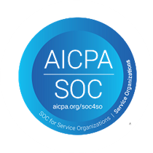
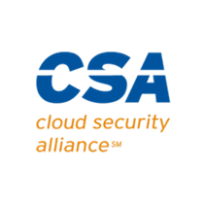

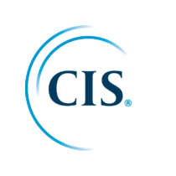

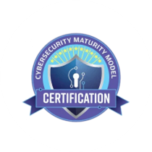
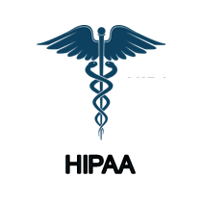



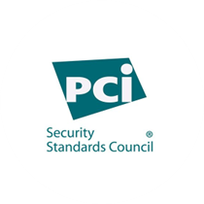
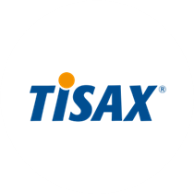
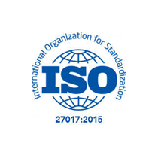
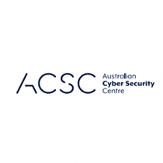

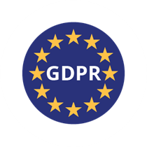
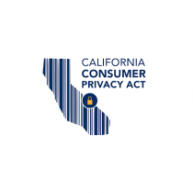
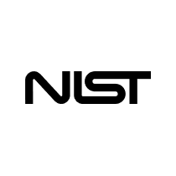

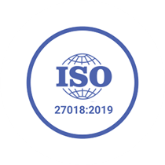
60+ frameworks across industries
and countries
Cross-mapped with 100+ pre-built compliance checks
Notes:
Look at these as business tools - each unlock thousands of clients

Slide 13










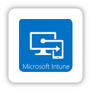

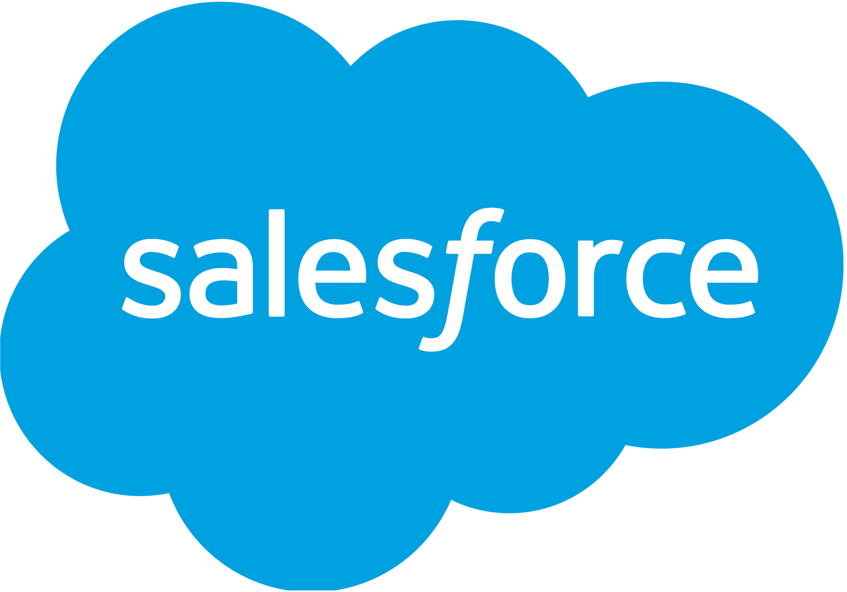



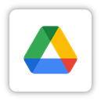

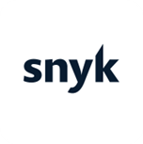
Automation & Integration Approach
for Cybersecurity Compliance

Slide 14
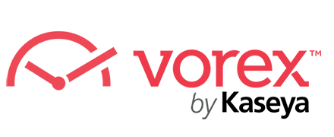
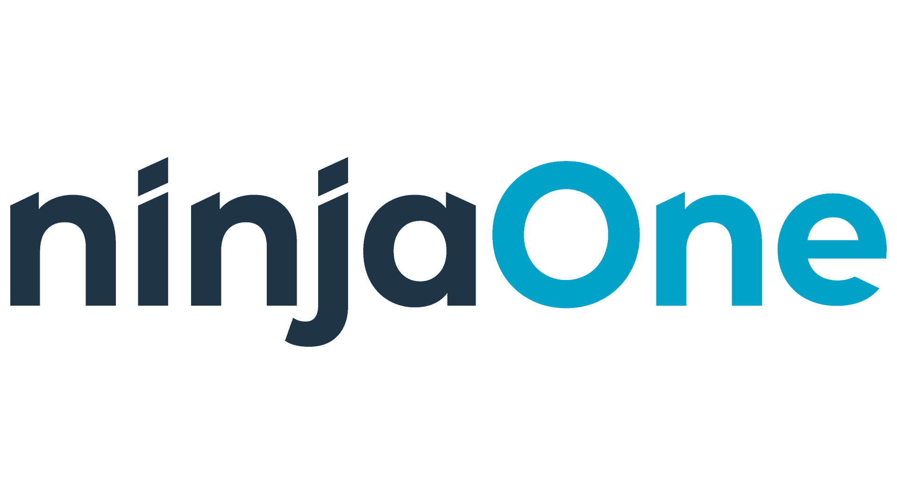
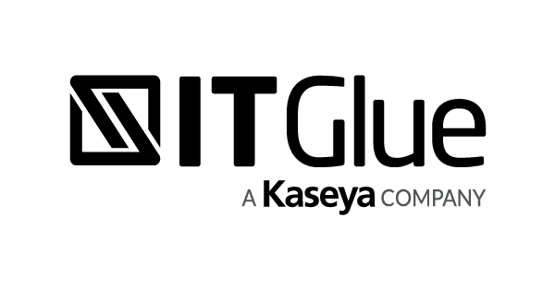
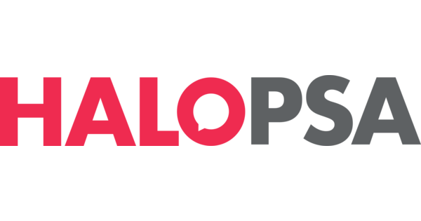
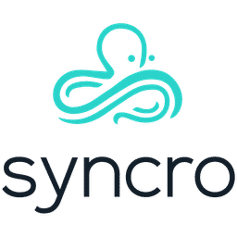


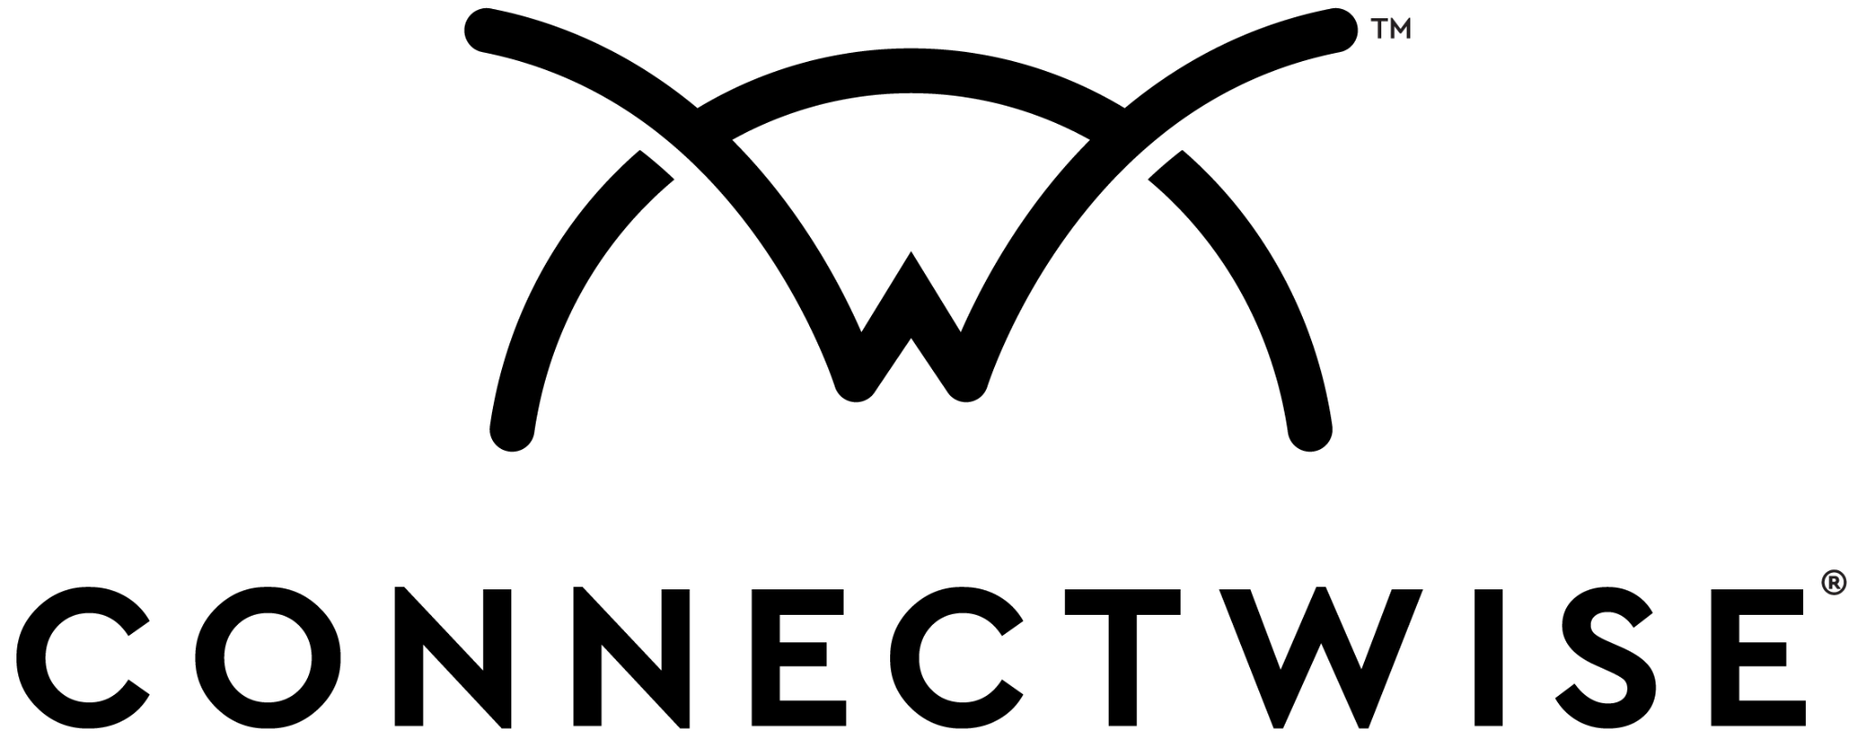


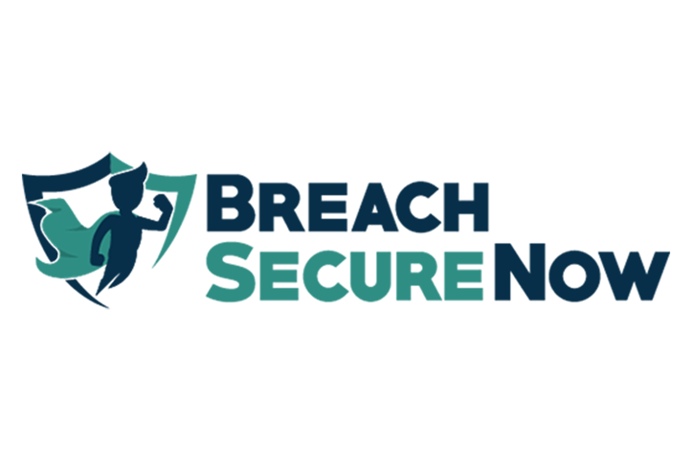
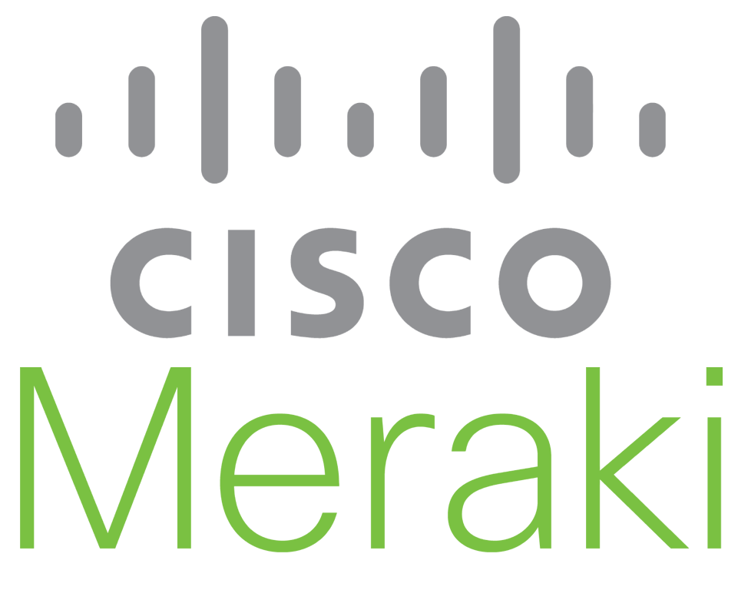
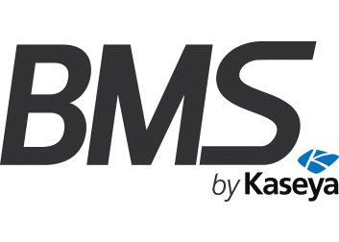
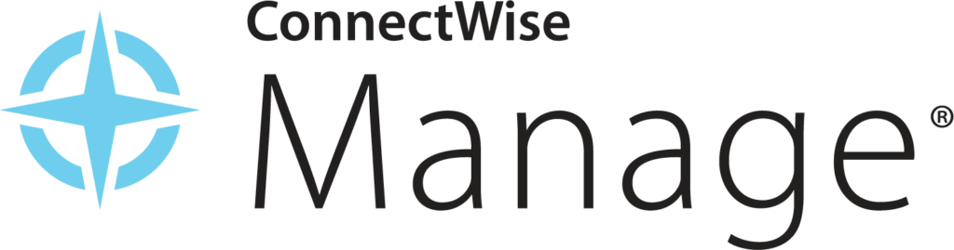
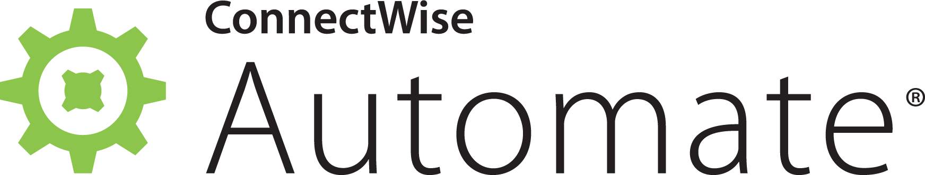
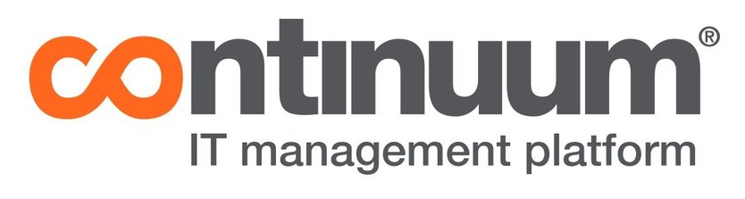
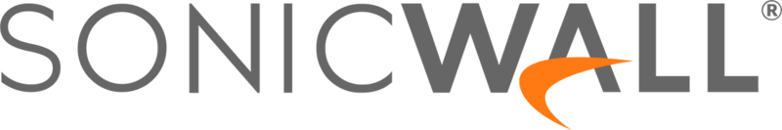
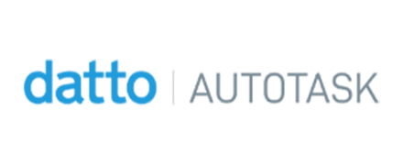
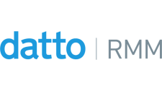
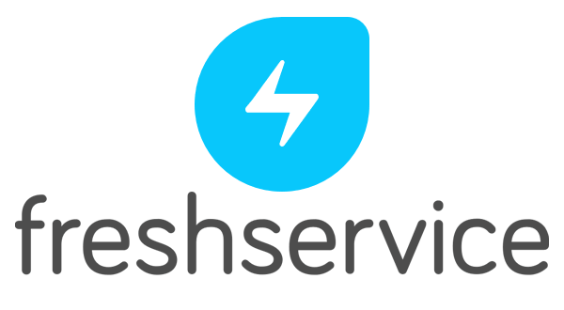

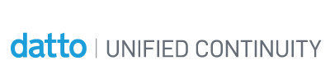
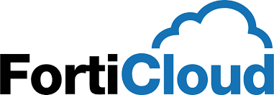

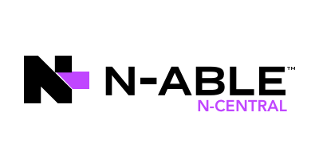
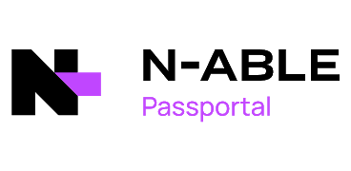
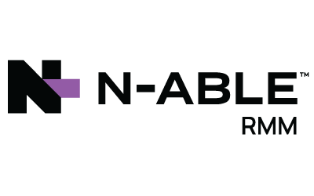
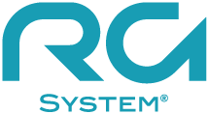
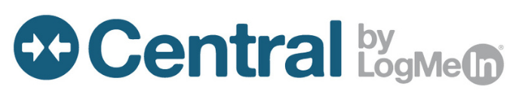
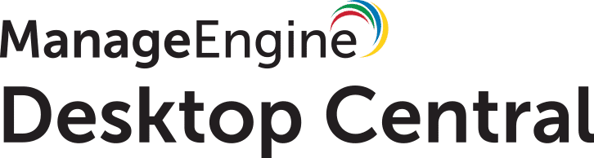
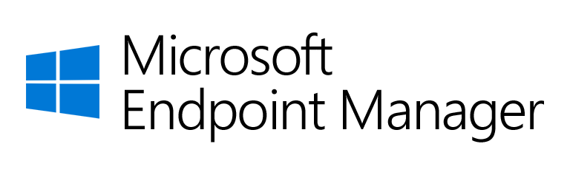

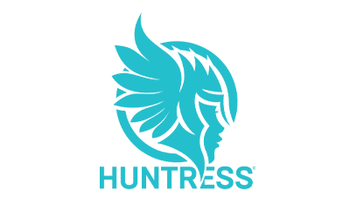
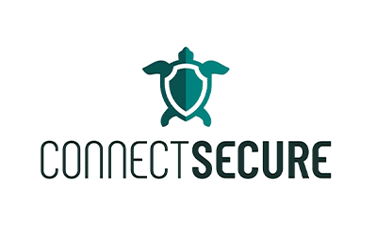


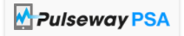
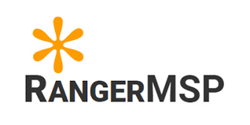


MSP Aligned: Integrations

Slide 15
CaaS Service:
MSPs / MSSPs / vCISO / InfoSec Consultants
Compliance Frameworks + Controls / Objectives Mgmt
Risk + 3rd Party Vendor risk
01
04
Compliance Assessments + Penetration tests
Policies, InfoSec, Incident response, breach remediation, communication plans, end user etc.
05
05
02
Become your client’s vCISO
Manage Trust Page / Framework Deliverables
Gaps = Roadmap cybersecurity solutions
03
06

Slide 16
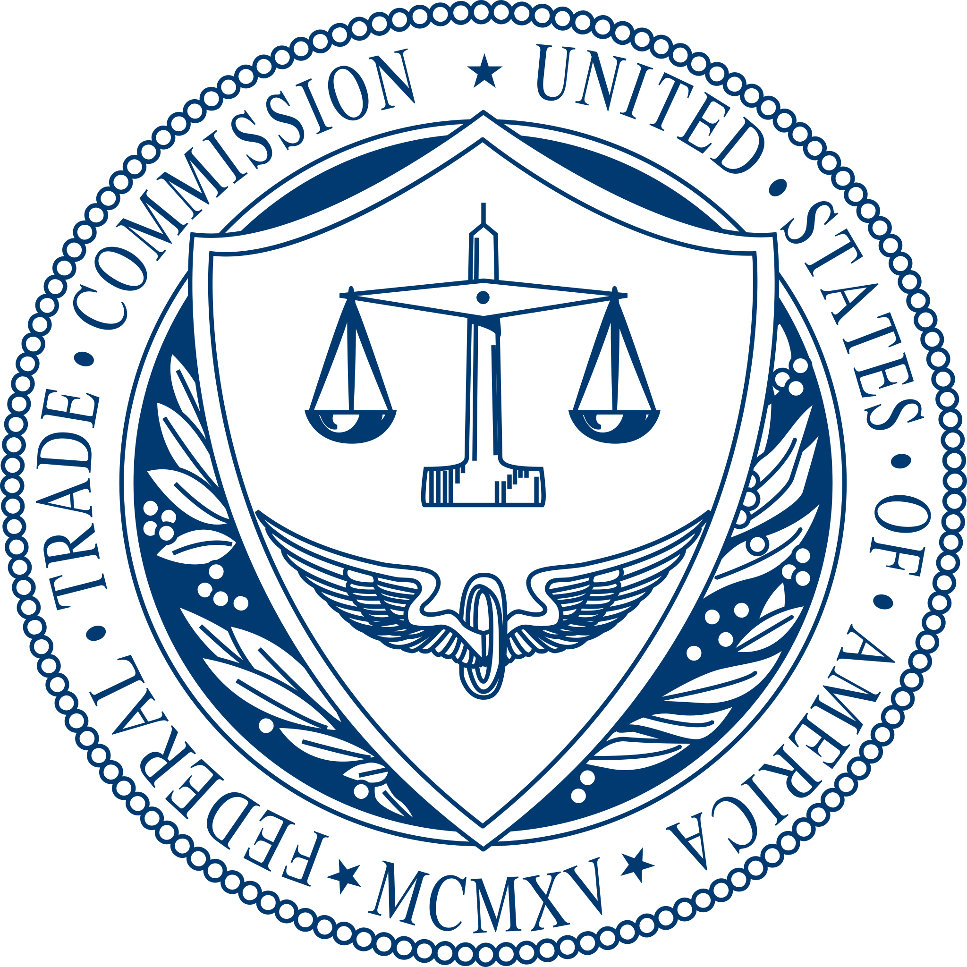
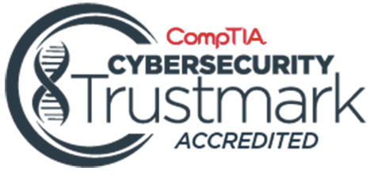
Audit: 3rd Party vs Self Assess
Self Assess
(Assessment Focus Less Evidence)
Framework
Policies
Trust Center
CISO MSP
Framework
Policies / Procedures
Asset Mgmt
Risk Assessment
Vendor Risk
Assessment**
Evidence**
Review
Both: Trust Center / Demonstrate Compliance
Auditor Statement
Certificate
Policies
Trust Center
3rd Party Audit
(Evidence Focused)

Slide 17

Compliance Health: Dashboard

Slide 18
Compliance Health: Dashboard

Slide 19

Compliance Health: Report

Slide 20

Compliance Health: Report

Slide 21

Where do vCISOs come from?
3. Where do vCISOs come from?
Former MSP Engineers or Security Leads
Compliance and Risk Consultants
IT Directors
or CIOs
Former MSSP or SOC Analysts
Cybersecurity Product
or Vendor Consultants
Governance and Audit Professionals
vCISO
Notes:
What a vCISO does (Personnel discussion)
Who can be the extra hat? Archetypes of build/evolve vs hire
vCISO touches every part of the MSP
Supporting roles: vCIO duties/support, early sales cycles
vCIO → vCISO
TAM → vCISO
Project Manager → vCISO

Slide 22


Slide 23





















ICON LIBRARY
Get started with these scalable icons, where appropriate.

Slide 24






ANIMATION LIBRARY
Use some animation to bring your presentation to life

